Slide 1
Google Data Analytics: Capstone Project- Bike Ride Analysis
I have completed this analysis as part of Google Data Analytics Beginner Certificate Program. I have decided to use my skills I gained through this program SQL on Google Bigquery and Tableau to complete this Capstone Project and add the case study to my Portfolio.
Background
About the company In 2016, Cyclistic launched a successful bike-share offering. Since then, the program has grown to a fleet of 5,824 bicycles that are geotracked and locked into a network of 692 stations across Chicago. The bikes can be unlocked from one station and returned to any other station in the system anytime. Until now, Cyclistic’s marketing strategy relied on building general awareness and appealing to broad consumer segments. One approach that helped make these things possible was the flexibility of its pricing plans: single-ride passes, full-day passes, and annual memberships. Customers who purchase single-ride or full-day passes are referred to as casual riders. Customers who purchase annual memberships are Cyclistic members.
Cyclistic’s finance analysts have concluded that annual members are much more profitable than casual riders. Although the pricing flexibility helps Cyclistic attract more customers, Moreno believes that maximizing the number of annual members will be key to future growth. Rather than creating a marketing campaign that targets all-new customers, Moreno believes there is a solid opportunity to convert casual riders into members. She notes that casual riders are already aware of the Cyclistic program and have chosen Cyclistic for their mobility needs. Moreno has set a clear goal: Design marketing strategies aimed at converting casual riders into annual members. In order to do that, however, the team needs to better understand how annual members and casual riders differ, why casual riders would buy a membership, and how digital media could affect their marketing tactics. Moreno and her team are interested in analyzing the Cyclistic historical bike trip data to identify trends.

Slide 2
Scenario
I am a junior data analyst working on the marketing analyst team at Cyclistic, a bike-share company in Chicago. The director of marketing believes the company’s
future success depends on maximizing the number of annual memberships. Therefore, my team wants to understand how casual riders and annual members use Cyclistic bikes differently. From these insights, my team will design a new marketing strategy to convert casual riders into annual members. But first, Cyclistic executives must approve my recommendations, so they must be backed up with compelling data insights and professional data visualizations.
Characters and teams
Cyclistic: A bike-share program that features more than 5,800 bicycles and 600 docking stations. Cyclistic sets itself apart by also offering reclining bikes, hand tricycles, and cargo bikes, making bike-share more inclusive to people with disabilities and riders who can’t use a standard two-wheeled bike. The majority of riders opt for traditional bikes; about 8% of riders use the assistive options. Cyclistic users are more likely to ride for leisure, but about 30% use the bikes to commute to work each day.
Key Stakeholders
Lily Moreno: The director of marketing and your manager. Moreno is responsible for the development of campaigns and initiatives to promote the bike-share program. These may include email, social media, and other channels.
Cyclistic marketing analytics team: A team of data analysts who are responsible for collecting, analyzing, and reporting data that helps guide Cyclistic marketing strategy. You joined this team six months ago and have been busy learning about Cyclist's mission and business goals—as well as how you, as a junior data analyst, can help Cyclistic achieve them.
Cyclistic executive team: The notoriously detail-oriented executive team will decide whether to approve the recommended marketing program.

Slide 3
Step 1: Ask
Three questions will guide the future marketing program: 1. How do annual members and casual riders use Cyclistic bikes differently? 2. Why would casual riders buy Cyclistic annual memberships? 3. How can Cyclists use digital media to influence casual riders to become members?
Step:2 Data Cleaning and Preparation
DATA COLLECTION
I will be using Cyclistic’s historical trip data from January 2023 to December 2023 to analyze and identify trends. (Note: The datasets have a different name because Cyclistic is a fictional company. For the purposes of this case study, the datasets are appropriate and will enable me to answer the business questions. The data has been made available by Motivate International Inc. under this license) This is public data that I can use to explore how different customer types are using Cyclistic bikes. But note that data-privacy issues prohibit me from using riders’ personally identifiable information.
This means that I won’t be able to connect pass purchases to credit card numbers to determine if casual riders live in the Cyclistic service area or if they have purchased multiple single passes. The dataset can be found here.

Slide 4
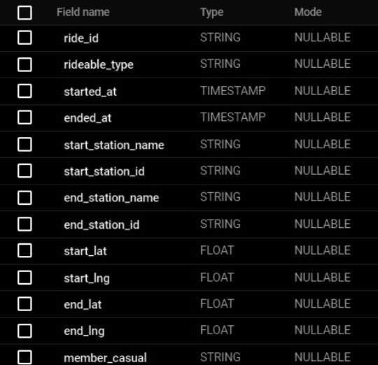
The ride details with 13 variables is shown below:
COMBINING ALL ROWS
In order to clean and explore the data further, I had to choose SQL on google’s BigQuery platform. The csv files were too large to be imported to Excel spreadsheet since they exceeded the capacity. I downloaded the csv files from Jan till Dec 2023 (Note: Sep dataset was missing ) and imported them to SQL. I then combined all the tables to Combined1_tripdata. Using the following query. While uploading I was notified that local uploads are limited to only 100 mb. I had to use Google Cloud storage to import. I created a bucket through Google Cloud storage to upload all the files to sql.
Combined Tables:
CREATE TABLE IF NOT EXISTS `bicycle-436922.bicycle_trip.Combined1_tripdata` AS (
SELECT * FROM `bicycle-436922.bicycle_trip.jan2023` UNION ALL
SELECT * FROM `bicycle-436922.bicycle_trip.feb2023`

Slide 5
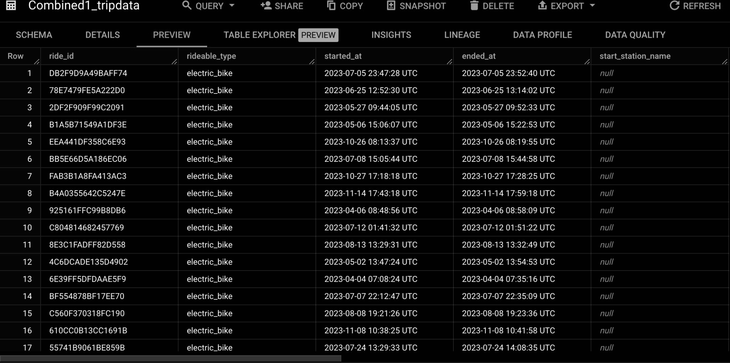
UNION ALL
SELECT * FROM `bicycle-436922.bicycle_trip.mar2023` UNION ALL
SELECT * FROM `bicycle-436922.bicycle_trip.apr2023` UNION ALL
SELECT * FROM `bicycle-436922.bicycle_trip.may2023` UNION ALL
SELECT * FROM `bicycle-436922.bicycle_trip.jun2023` UNION ALL
SELECT * FROM `bicycle-436922.bicycle_trip.july2023` UNION ALL
SELECT * FROM `bicycle-436922.bicycle_trip.aug2023` UNION ALL
SELECT * FROM `bicycle-436922.bicycle_trip.oct2023` UNION ALL
SELECT * FROM `bicycle-436922.bicycle_trip.nov2023` UNION ALL
SELECT * FROM `bicycle-436922.bicycle_trip.dec2023`
)

Slide 6
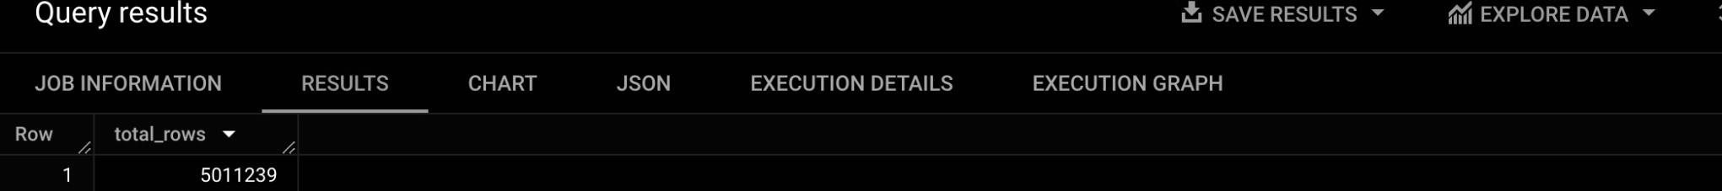
View the table
SELECT *
FROM `bicycle-436922.bicycle_trip.Combined1_tripdata` LIMIT 10;
Data Observation
Verifying the size of rows
SELECT COUNT(*) AS total_rows
FROM `bicycle-436922.bicycle_trip.Combined1_tripdata`;
Step 3: Process
I decided to analyze the quantity of null values by checking for the number of null values in all columns.
SELECT 'null_count_ride_id' AS column_name, COUNT(*) AS count_value
FROM `bicycle-436922.bicycle_trip.Combined1_tripdata`
WHERE ride_id IS NULL
UNION ALL
SELECT 'null_count_rideable_type', COUNT(*)
FROM `bicycle-436922.bicycle_trip.Combined1_tripdata`
WHERE rideable_type IS NULL
UNION ALL

Slide 7
SELECT 'null_count_started_at', COUNT(*)
FROM `bicycle-436922.bicycle_trip.Combined1_tripdata`
WHERE started_at IS NULL UNION ALL
SELECT 'null_count_ended_at', COUNT(*)
FROM `bicycle-436922.bicycle_trip.Combined1_tripdata`
WHERE ended_at IS NULL UNION ALL
SELECT 'null_count_start_station_name', COUNT(*) FROM `bicycle-436922.bicycle_trip.Combined1_tripdata`
WHERE start_station_name IS NULL UNION ALL
SELECT 'null_count_start_station_id', COUNT(*)
FROM `bicycle-436922.bicycle_trip.Combined1_tripdata`
WHERE start_station_id IS NULL UNION ALL
SELECT 'null_count_end_station_name', COUNT(*)
FROM `bicycle-436922.bicycle_trip.Combined1_tripdata`
WHERE end_station_name IS NULL UNION ALL
SELECT 'null_count_end_station_id', COUNT(*)
FROM `bicycle-436922.bicycle_trip.Combined1_tripdata`
WHERE end_station_id IS NULL UNION ALL
SELECT 'null_count_start_lat', COUNT(*)
FROM `bicycle-436922.bicycle_trip.Combined1_tripdata`
WHERE start_lat IS NULL UNION ALL
SELECT 'null_count_start_lng', COUNT(*)
FROM `bicycle-436922.bicycle_trip.Combined1_tripdata`
WHERE start_lng IS NULL UNION ALL
SELECT 'null_count_end_lat', COUNT(*)
FROM `bicycle-436922.bicycle_trip.Combined1_tripdata`
WHERE end_lat IS NULL UNION ALL
SELECT 'null_count_end_lng', COUNT(*)
FROM `bicycle-436922.bicycle_trip.Combined1_tripdata`

Slide 8
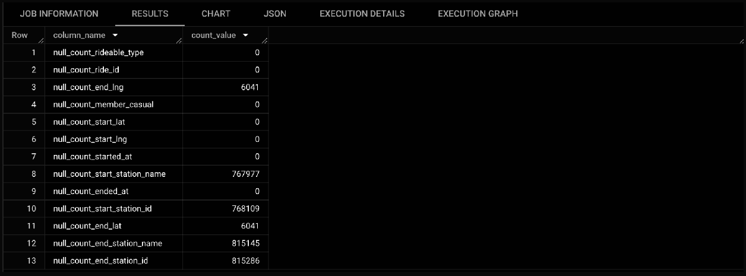
WHERE end_lng IS NULL
UNION ALL
SELECT 'null_count_member_casual', COUNT(*)
FROM `bicycle-436922.bicycle_trip.Combined1_tripdata`
WHERE member_casual IS NULL;
Checking for duplicates
SELECT COUNT(*) AS total_duplicate_rows
FROM `bicycle-436922.bicycle_trip.Combined1_tripdata` GROUP BY
ride_id, rideable_type, started_at, ended_at, start_station_name, start_station_id, end_station_name, end_station_id, start_lat, start_lng,
end_lat,

Slide 9
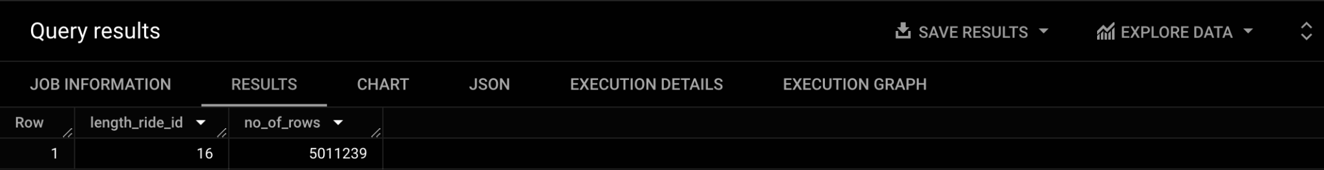
end_lng,
member_casual
HAVING COUNT(*) > 1;
No duplicate rows
Find the length of the ride id to make sure they are consistent.
SELECT LENGTH (ride_id) AS length_ride_id, COUNT(*) AS no_of_rows FROM `bicycle-436922.bicycle_trip.Combined1_tripdata`
GROUP BY length_ride_id
Obviously, there are problems with the data if there are negative ride lengths and rides lasting for days. I wrote these queries to see how many rides were negative or lasted longer than one day.
SELECT ride_id, started_at, ended_at,
TIMESTAMP_DIFF(ended_at,started_at,MINUTE) AS negative_ride_length_in_minutes, COUNT(ride_id) AS no_of_rows
FROM `bicycle-436922.bicycle_trip.Combined1_tripdata` WHERE TIMESTAMP_DIFF(ended_at,started_at,MINUTE) <=1 GROUP BY ride_id,started_at, ended_at;

Slide 10
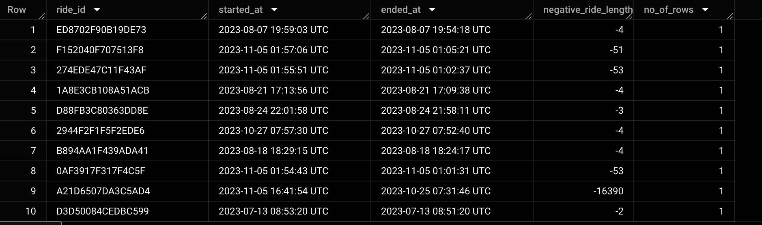
Step 4: Data Analysis
Now that the data is cleaned and ready for analysis. I am going to focus on exploring
information related to types of bikes, number of trips and average ride length.
After
processing and cleaning the data, I queried the data to answer the following questions:
Find the Ride Types?
What’s the ride length in minutes ?
How many cyclists per month per rider category?
How many cyclists per week per rider category?
How many rides per hour?
What is the average ride length , min and max per cyclist category?
How many cyclists per day per rider category?
What is the average ride length per day per cyclist category?
What’s the popular day among the riders?
What’s the popular start station among the riders?
1. Find the popular ride types?
This analysis was done to figure out which is the popular bike among riders. There are three types of bikes: Electric, Classic, Docked. The query below shows that electric bikes seem to be more popular than the other two bikes.

Slide 11
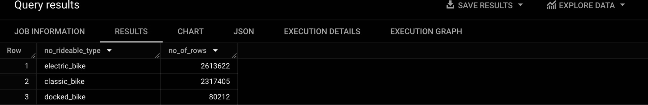
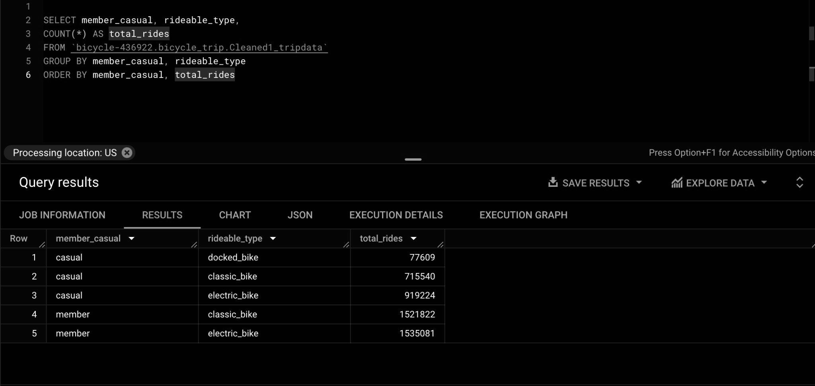
SELECT DISTINCT (rideable_type) AS no_rideable_type, COUNT(*) AS no_of_rows
FROM `bicycle-436922.bicycle_trip.Combined1_tripdata` GROUP BY no_rideable_type
--Ride Types by Casual and Members riders.
Next, I tried to analyze the popular bike used among casual and member riders. Interestingly, Both the riders favored electric bikes for their rides.It looks like the member riders opted out to use docked bikes at any point.
2. What’s the ride length in minutes ?
I Calculated through the TIMESTAMP_DIFF function. This function subtracts timestamps and returns the unit of time indicated. In this case, I used MINUTE.

Slide 12
TIMESTAMP_DIFF(ended_at, started_at, MINUTE) AS ride_length_in_mins
I then calculated day of the week and month by using EXTRACT to extract month from started_at and EXTRACT day of the week from started_at. I have added 3 extra column ride length in mins, day of week and month. Along with that I removed the rides with shorter duration of less than a min or longer than 24 hrs.
CREATE TABLE `bicycle-436922.bicycle_trip.Cleaned1_tripdata` AS (
SELECT
ride_id, rideable_type, started_at, ended_at, ride_length_in_mins, CASE
EXTRACT(MONTH FROM started_at)
WHEN | 1 | THEN | 'January'
WHEN | 2 | THEN | 'February'
WHEN | 3 | THEN | 'March'
WHEN | 4 | THEN | 'April'
WHEN | 5 | THEN | 'May'
WHEN | 6 | THEN | 'June'
WHEN | 7 | THEN | 'July'
WHEN | 8 | THEN | 'August'
WHEN | 9 | THEN | 'September'
WHEN | 10 | THEN | 'October'
WHEN | 11 | THEN | 'November'
WHEN | 12 | THEN | 'December'
END AS month,
CASE EXTRACT(DAYOFWEEK FROM started_at) WHEN 1 THEN 'Sunday'
WHEN 2 THEN 'Monday'
WHEN 3 THEN 'Tuesday' WHEN 4 THEN 'Wednesday'

Slide 13
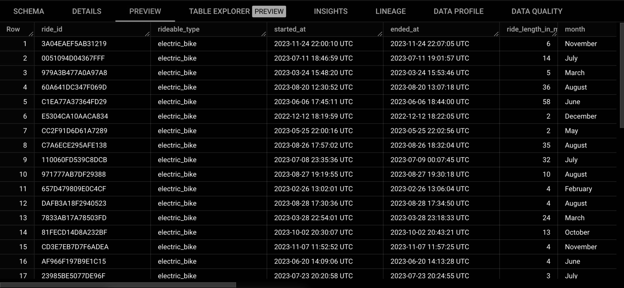
WHEN 5 THEN 'Thursday'
WHEN 6 THEN 'Friday'
WHEN 7 THEN 'Saturday' END AS day_of_week, start_station_name, start_station_id, end_station_name, end_station_id, start_lat,
start_lng, end_lat, end_lng, member_casual,
FROM `bicycle-436922.bicycle_trip.Combined1_tripdata` AS t1 JOIN
(SELECT ride_id,
TIMESTAMP_DIFF(ended_at, started_at, MINUTE) AS ride_length_in_mins FROM `bicycle-436922.bicycle_trip.Combined1_tripdata`) AS t2 USING(ride_id)
WHERE ride_length_in_mins > 1 AND ride_length_in_mins < 1440);
This statement created a new table named Cleaned1_tripdata.

Slide 14
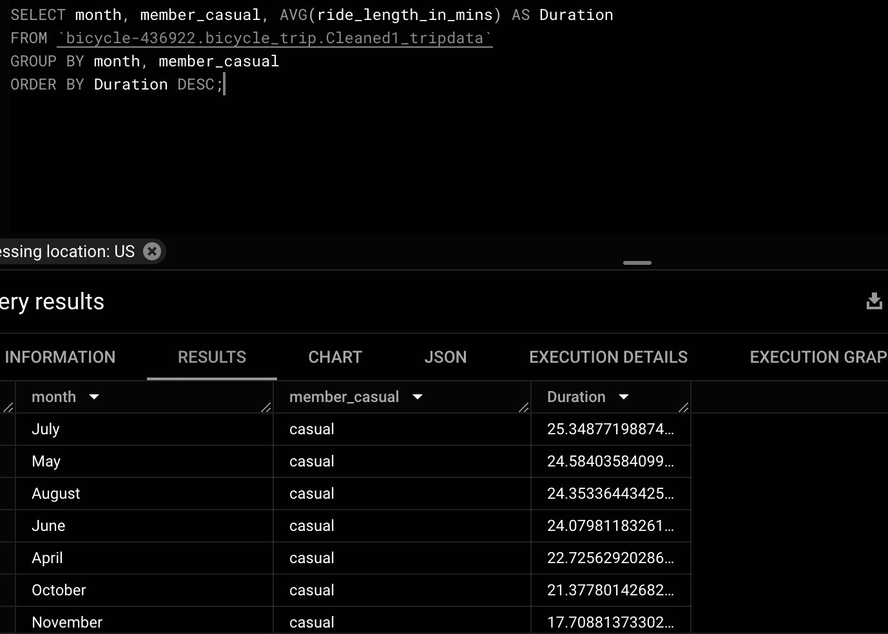
3. How many rides per month does each rider takes?
SELECT member_casual, month, COUNT(*) AS total_rides_per_month
FROM `bicycle-436922.bicycle_trip.Cleaned1_tripdata` GROUP BY member_casual, month
ORDER BY member_casual;

Slide 15
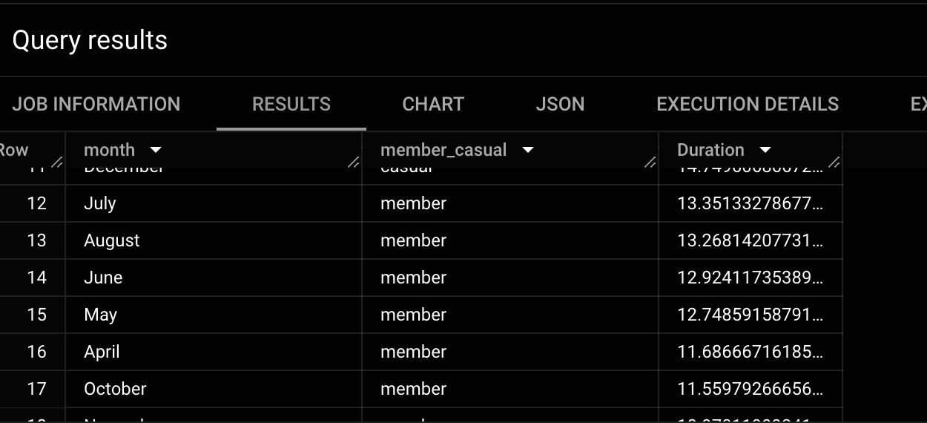
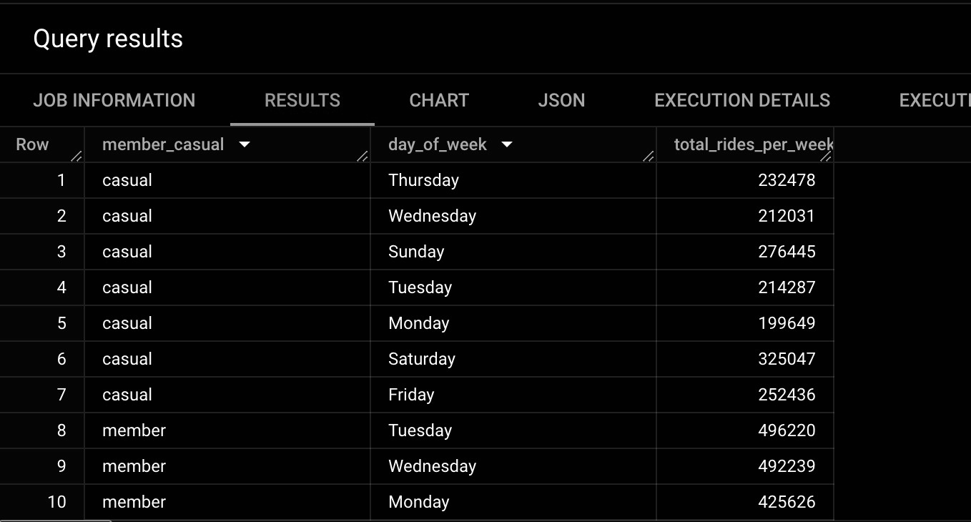
4.How many rides per week does each rider take?
SELECT member_casual, day_of_week,COUNT(*) AS total_rides_per_week FROM `bicycle-436922.bicycle_trip.Cleaned1_tripdata`
GROUP BY member_casual,day_of_week ORDER BY member_casual;

Slide 16
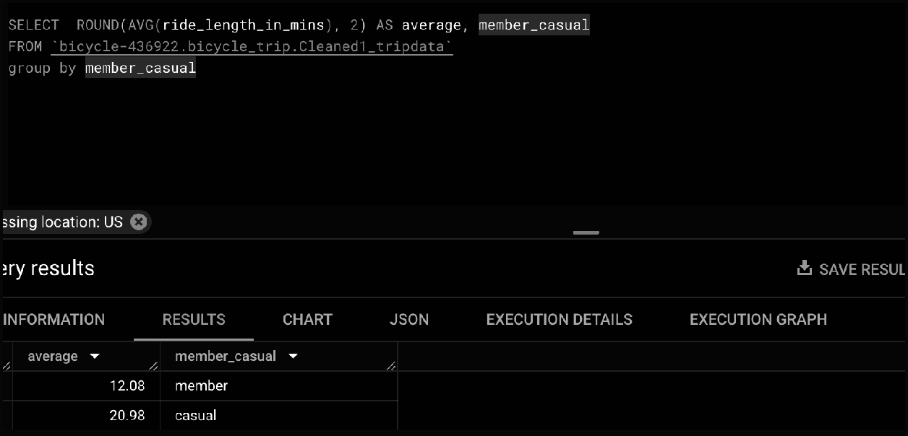
SELECT member_casual, day_of_week,COUNT(*) AS total_rides_per_week
FROM `bicycle-436922.bicycle_trip.Cleaned1_tripdata` GROUP BY member_casual,day_of_week
ORDER BY member_casual;
5.How many rides per hour does each rider take?
SELECT member_casual,
EXTRACT(HOUR FROM started_at) AS hour_of_day, COUNT(*) AS total_trips
FROM `bicycle-436922.bicycle_trip.Cleaned1_tripdata` GROUP BY member_casual,hour_of_day
ORDER BY member_casual;
6.What's the average,min and max ride length among the riders?
Analysis of Average Ride length, min and max ride length member vs casual riders.

Slide 17
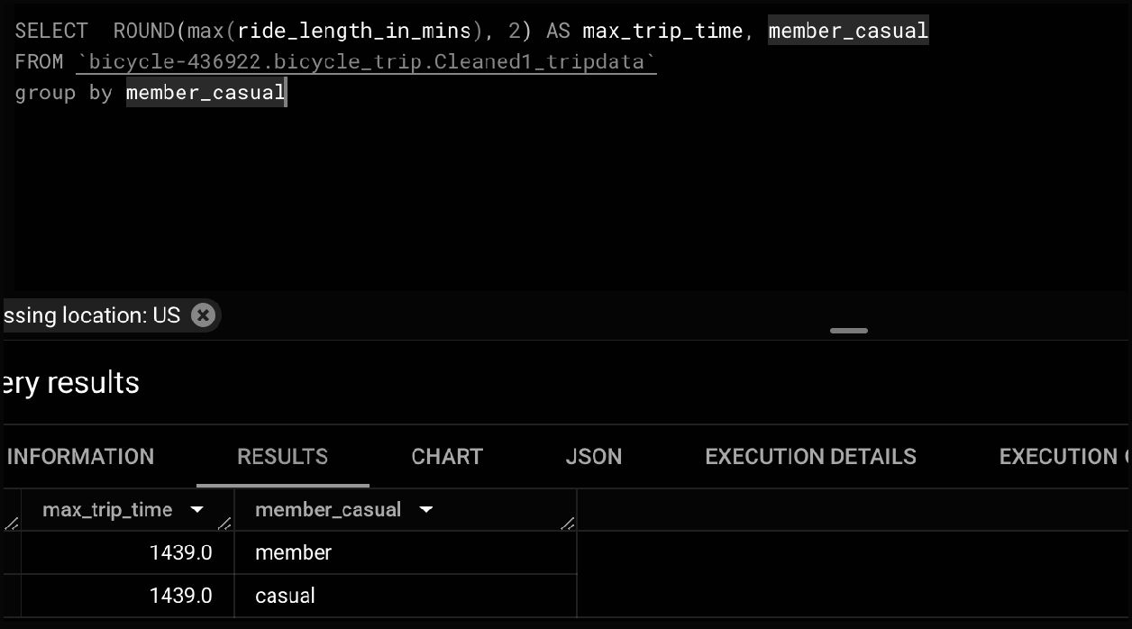
The above query shows that casual riders average ride length takes around 20 min
more than member riders.
--max trip time for both members
As you can see that the max of ride length in mins for causal and member riders is
1439.0 mins
---- minimum amount of time spent on a bike

Slide 18
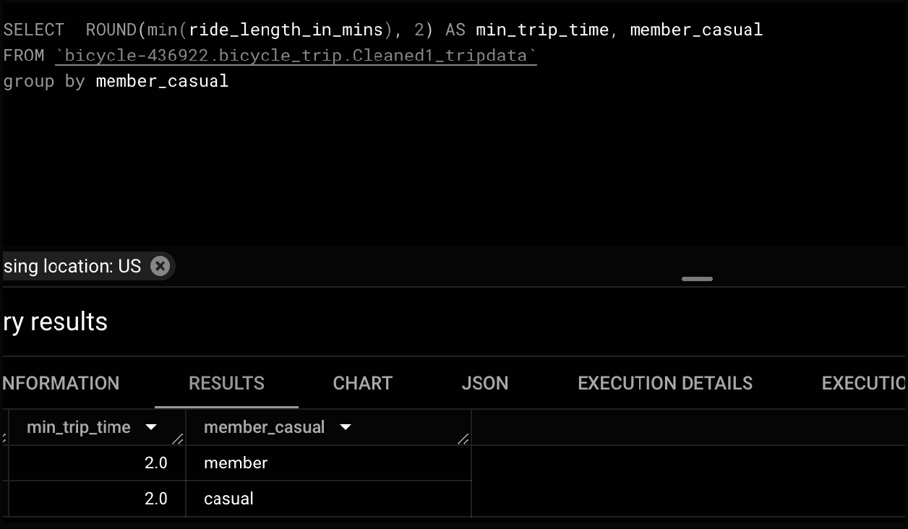
7.What is the most popular day for casual riders?
---- Analysis on the most popular and least popular day for casual riders.

Slide 19
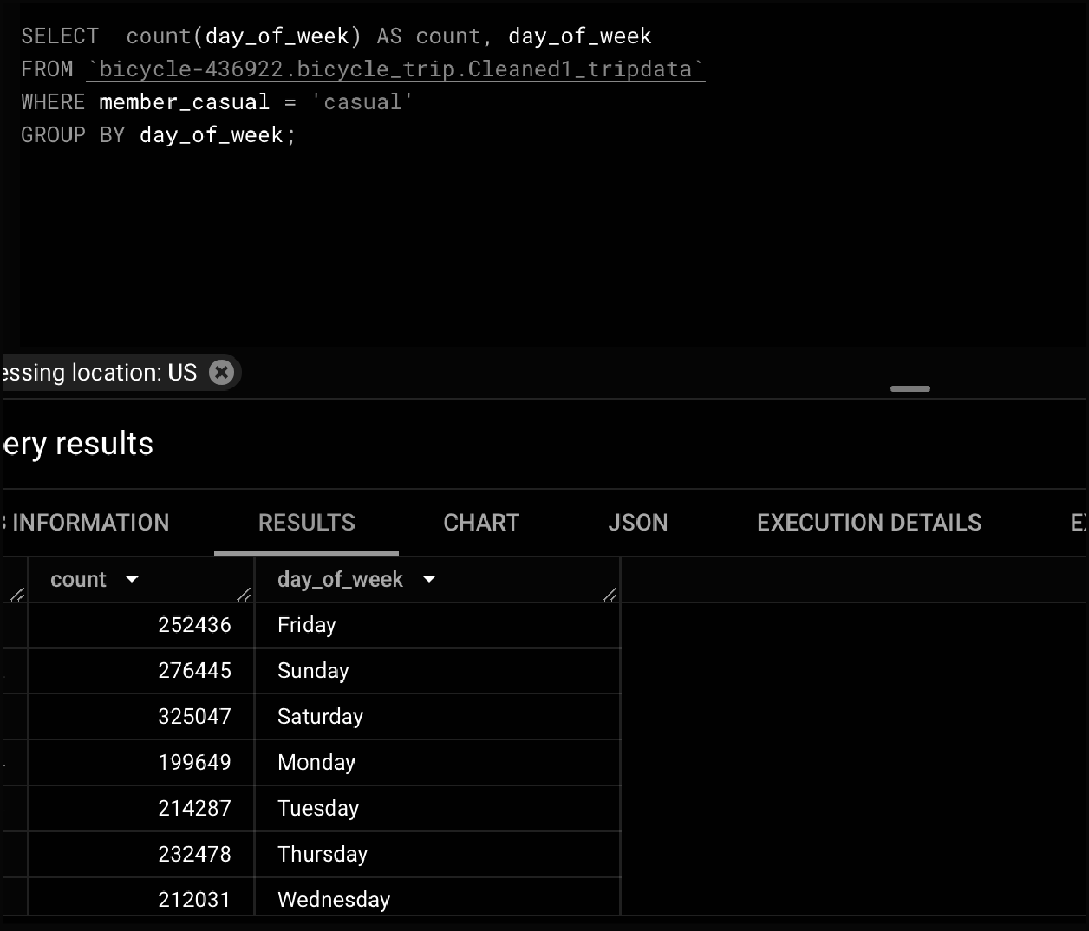
8.What is the most popular day for member riders?
The query below helps to understand the most popular and least popular day for
member riders. Thursday seems to be popular and Sunday seems to be least popular
among member riders.

Slide 20
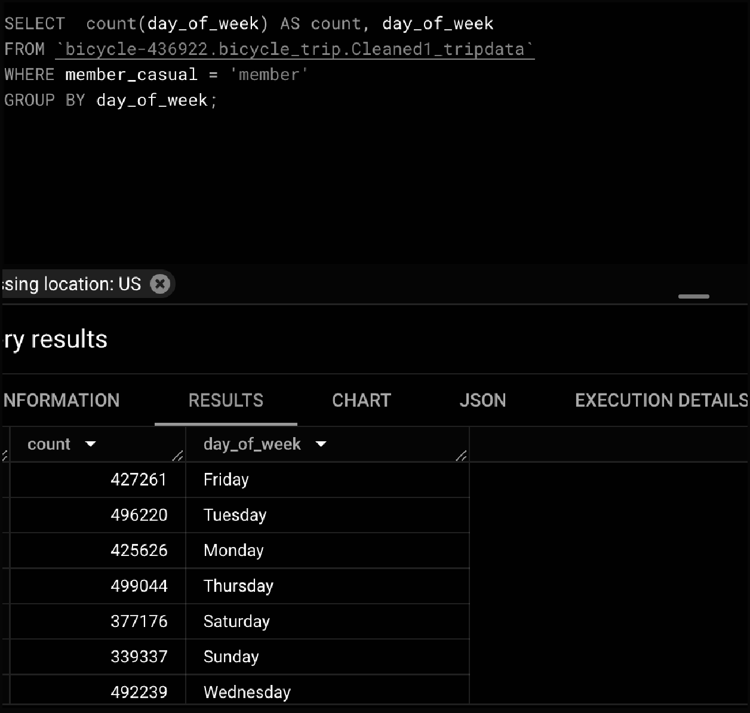

Slide 21
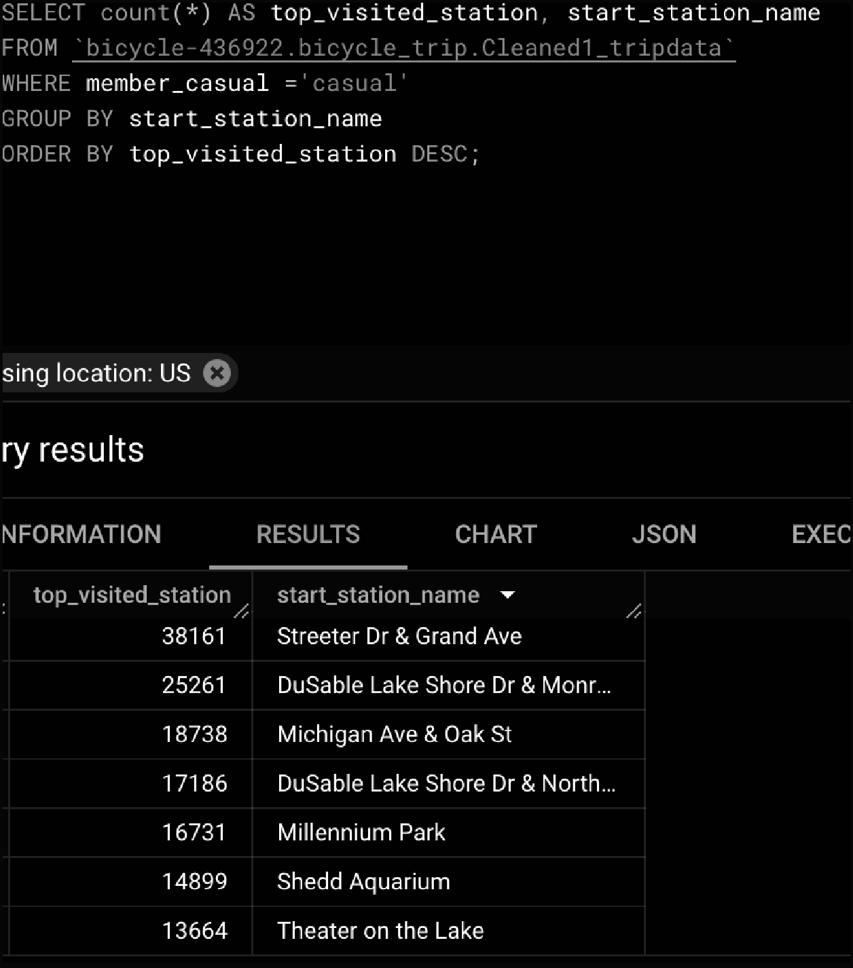
9.What is the most popular start station name for casual riders?

Slide 22
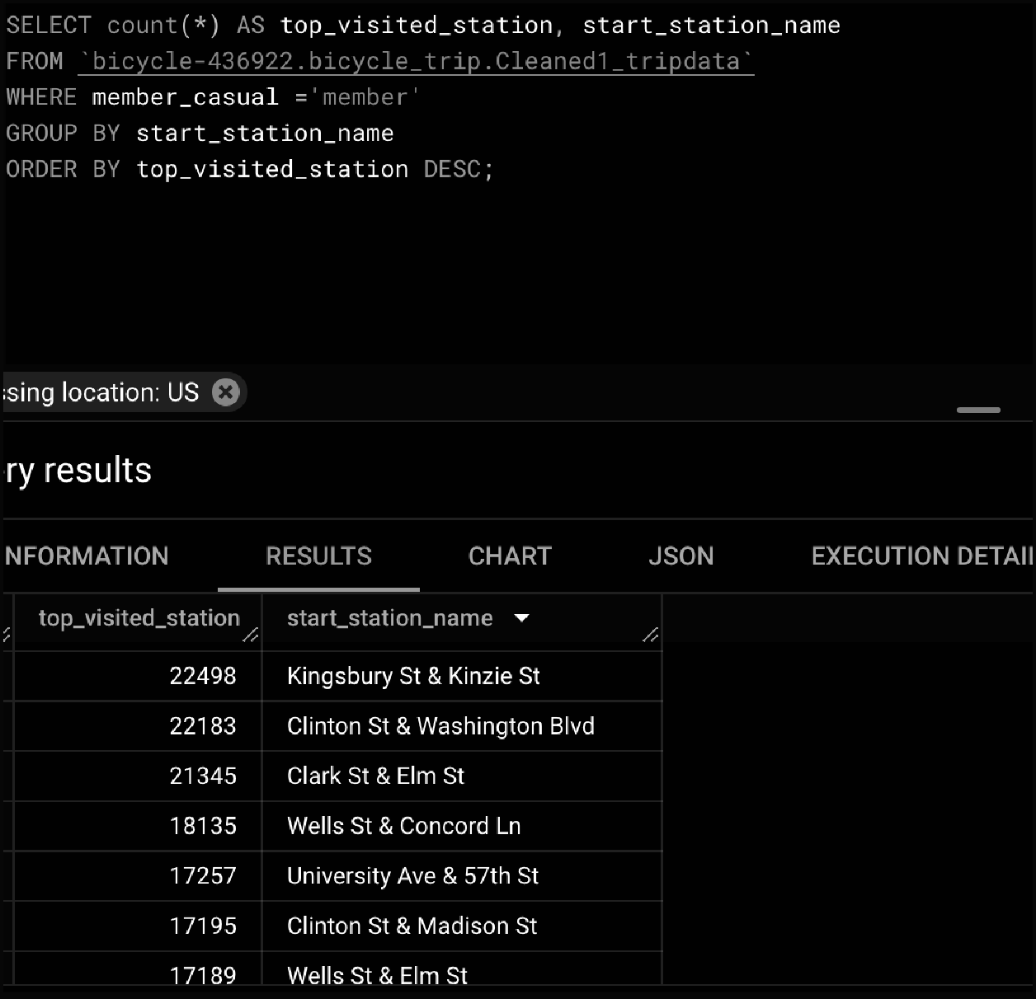
It seems from the above result that the frequently visited start station by casual riders
are Streeter Dr & Grand ave.
10.What is the most popular start station name for member riders?
The above result clearly shows that the most frequently used and popular start station
by members is Kingsbury St & Kinzie St.

Slide 23
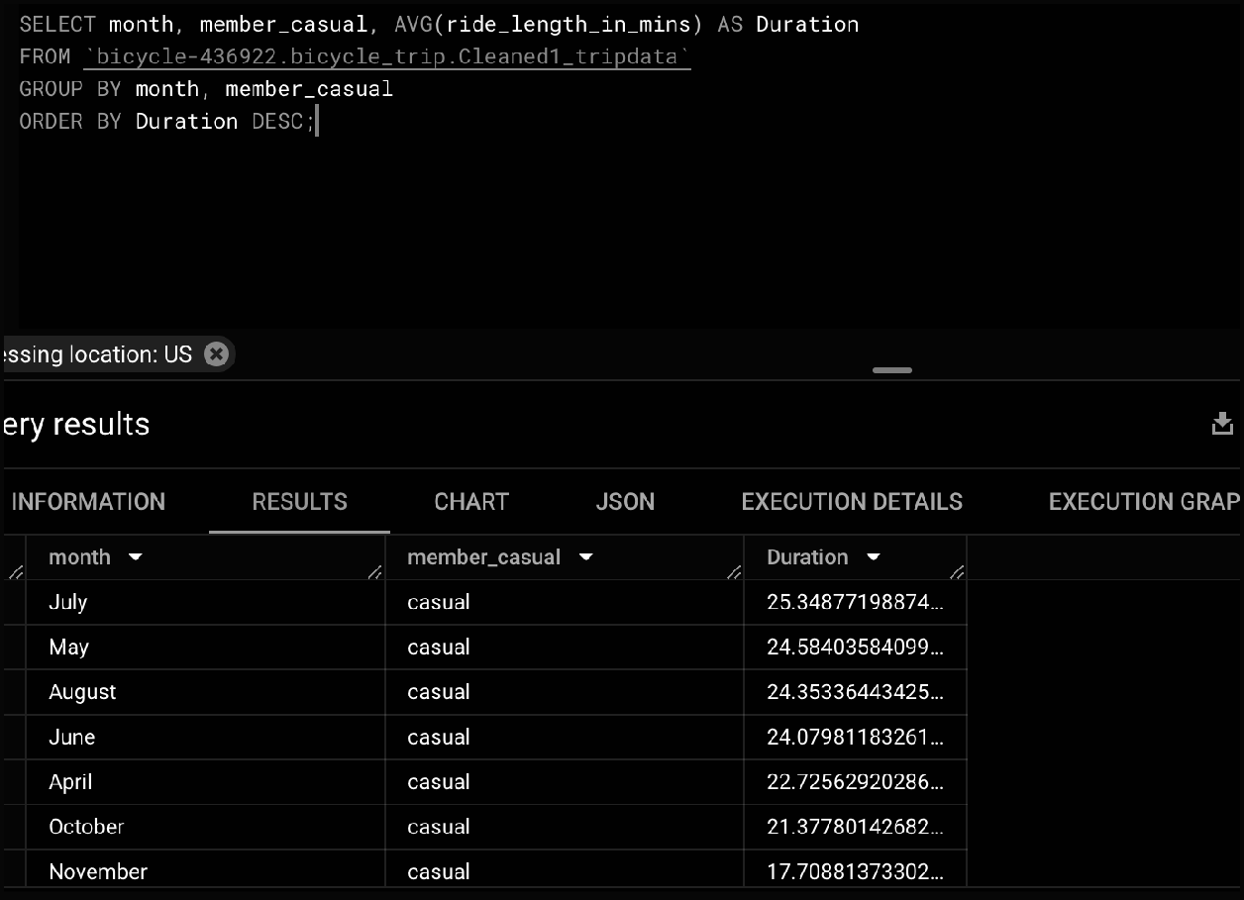
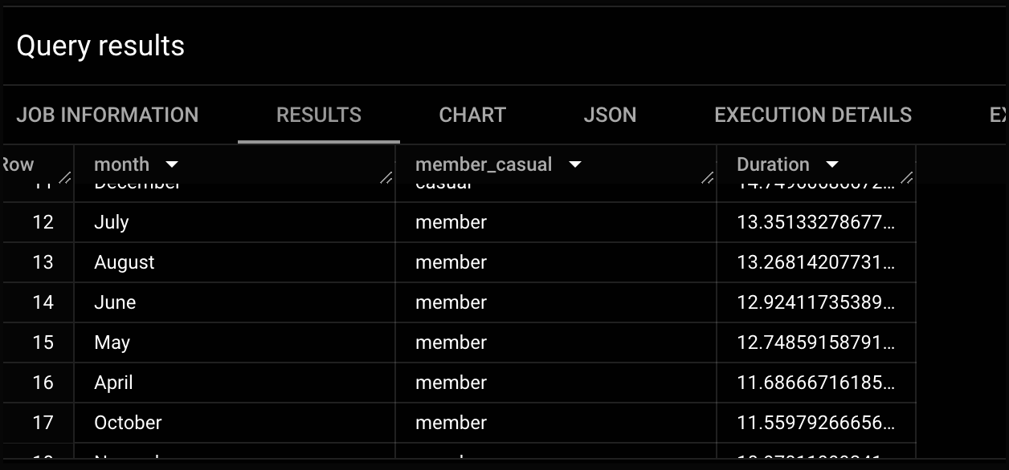
11.How many average rides per month by both the riders?

Slide 24
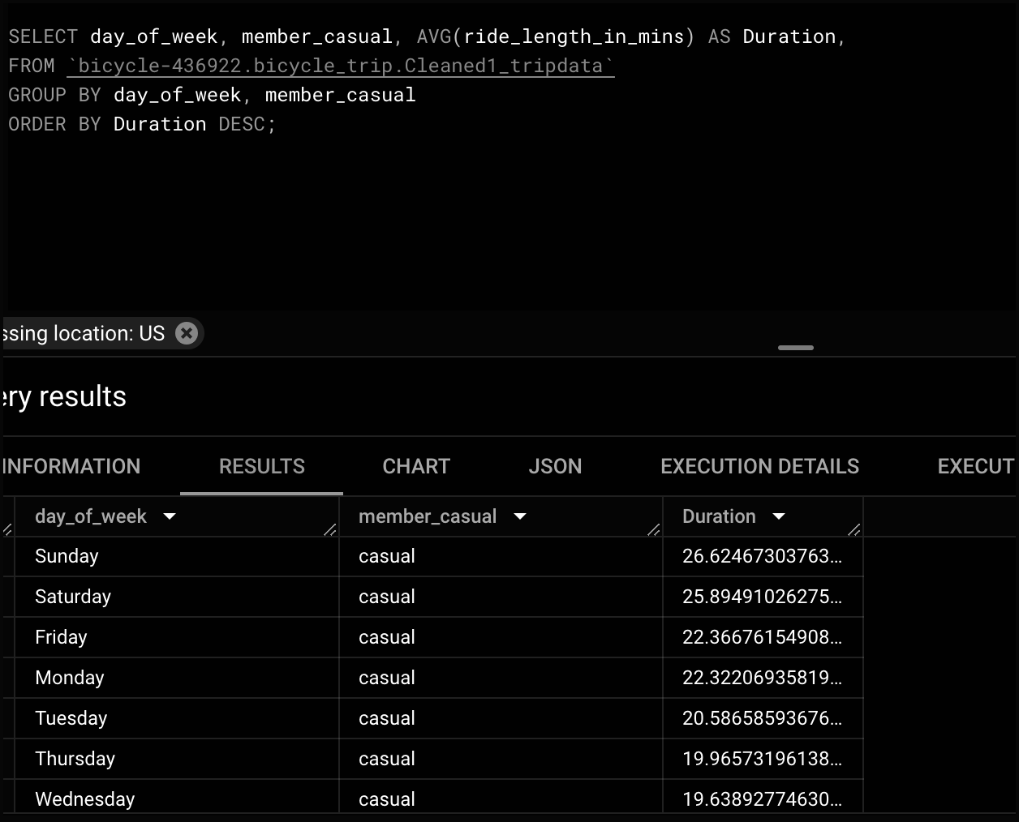
From the analysis it clearly shows that both the riders have reached their highest avg
riding activity in July. Both of them experienced their lowest activity in January.
12. How many rides per day does each rider take ?

Slide 25
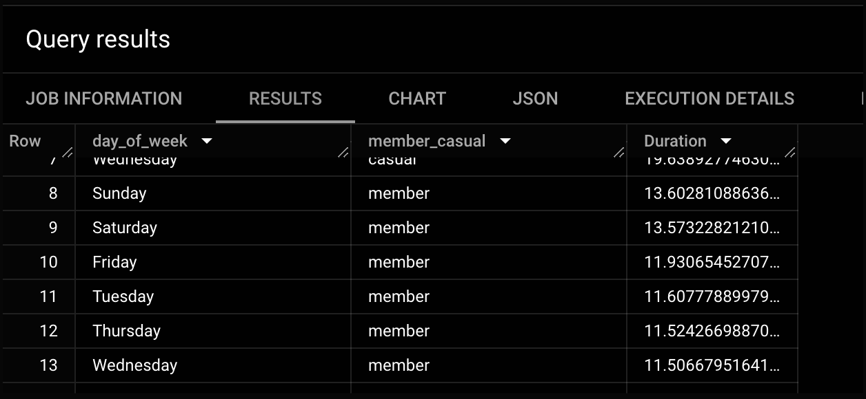
From the above result it can be seen that most rides by members and casual occurred
during the weekends. If we investigate further by following the query. It clearly shows
that members have taken higher trips than casual riders. Which shows that members
use the service more on weekdays and casual riders on weekends.

Slide 26
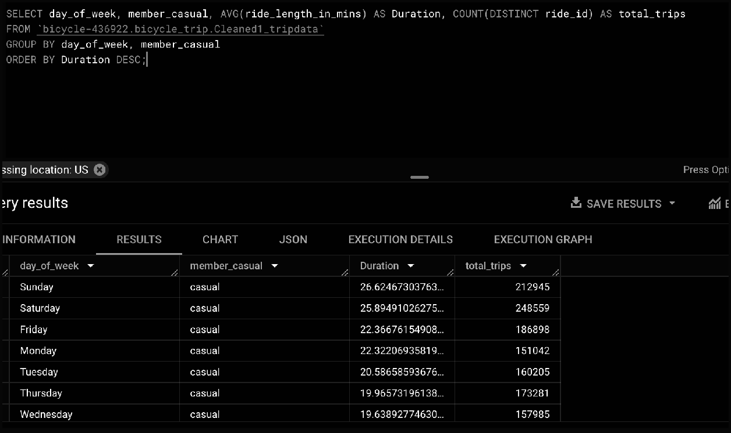
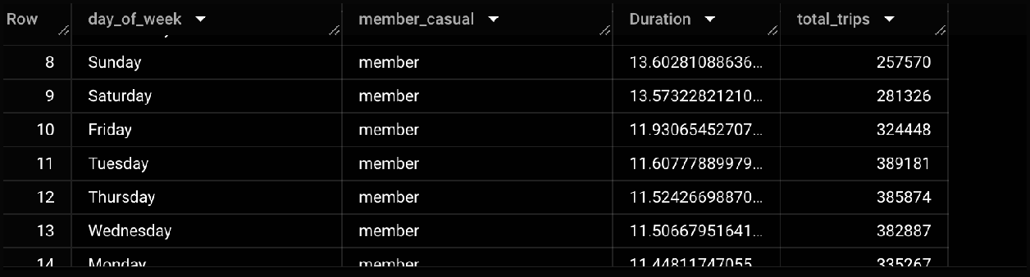
Share
Now that I have done some research and gained some insights from the data. I need to
create visualizations and share it with the shareholders. I used Tableau for creating
some insightful visualizations.
Here’s my dashboard with relevant visualizations at a glimpse.
https://public.tableau.com/app/profile/deepa.saravanan6315/viz/GoogleDataA
nalyticsDashboard-BikeRideAnalysis/GoogleDataAnalyticsDashboard-BikeRideAn
alysis

Slide 27
Act:
Now that I have finished completing my visualizations. The final phase includes
providing recommendations based on my findings.
1. Seasonal Membership option: Introduce discounted seasonal membership offers
to attract more riders during the summer to capture a significant number of riders.
Also, Consider providing annual membership discounts to casual cyclists.
2. Consider promoting membership events near stations to promote more visibility
and pass on flyers which emphasize the positive impact of fitness which can help
reduce stress and improve overall well being.
3. Showcase the benefits of bikeshare especially electric bikes and their impact on
a sustainable environment. This can be done through social media platforms like
Facebook, Twitter and Instagram.

